Slide 1
Preparing for Christmas Gingerbread making
C.S.E.I.”Cristal” Oradea

Slide 2
RECIPE
150 grams of butter with 82% fat
150 grams of brown sugar (white sugar can also be used, but gingerbread will have a lighter color)
200 grams of bee honey
1 whole egg
½ teaspoon of salt
1 teaspoon (10 grams) baking soda
450 grams of flour + flour for sprinkling the worktop
1 tablespoon vanilla extract (or, failing that, 1 sachet of vanilla sugar)
1 teaspoon cinnamon powder
1 teaspoon ginger powder
½ teaspoon allspice powder
¼ teaspoon nutmeg powder
8 cloves
2 cardamom pods

Slide 3
Baking
Finely grind the cloves and cardamom
Add over flour (450 grams), followed by cinnamon, ginger, allspice, nutmeg, salt and baking soda.Mix well and set aside.
The honey is weighed in a large bowl, add soft butter and sugar over the honey. Mix everything with the mixer on high speed for 5 minutes, then add the whole egg and vanilla extract and continue mixing until the egg is incorporated. Be careful, at this stage it is possible for the butter to separate (usually if the egg is too cold), it doesn't matter, the gingerbread will do just as well.

Slide 4
Over the mixture with butter and honey from the bowl, add the flour with the spices.At the beginning we will mix with a wooden spoon or a solid spatula, after we will have to start kneading. The dough does not knead much, only 1-2 minutes, to homogenize the gingerbread dough.
Sprinkle the work surface with flour, turn the gingerbread out of the bowl and shape it into a regular shape, allowing us to divide it into two equal pieces. Shape each round piece, then flatten and wrap each, separately, in cling film.
The dough thus packed is refrigerated for a minimum of 8 hours, a maximum of 72 hours.

Slide 5
After the rest time, the gingerbread is removed from the refrigerator and left for about 30 minutes at room temperature. Meanwhile, turn on the oven and heat to 175 °
Sprinkle the work surface with flour, unpack a piece of gingerbread and place it on it. Sprinkle the dough with flour and on the surface, also powder a little the rolling pin. The dough is spread on a sheet with a uniform thickness of ½cm.
Cut the gingerbread into shapes as you like, the same or different. Place the cut shapes in trays covered with baking paper, with a distance of about 2 cm between them and bake one at a time, at a medium height, for 10-12 minutes, until with a golden tint and the edges are lightly colored.
Gather the remaining edges of the cut together, spread the dough with the rolling pin and proceed in the same way as in point .Repeat until the dough is exhausted.
Immediately after baking, the gingerbread will be very fragile, so we need to let it cool well in the pan. When cold, the figurines harden like biscuits.

Slide 6
Royal icing: 1 fresh egg white 120 grams of powdered sugar 1 tablespoon lemon juice
Put the raw egg white in a bowl, beat with a mixer until a thick foam is formed. Add the powdered sugar, gradually, while mixing continuously at medium speed
After all the powdered sugar has been incorporated, we will add lemon juice over the mixture in the bowl and mix the composition on high speed, about 5-6 minutes or as needed as from the initial appearance of thick cream, which it had after incorporation of sugar, increase in volume and harden very strongly, forming firm ridges on the surface. At this stage, food coloring can be added to the egg white glaze, if desired

Slide 7
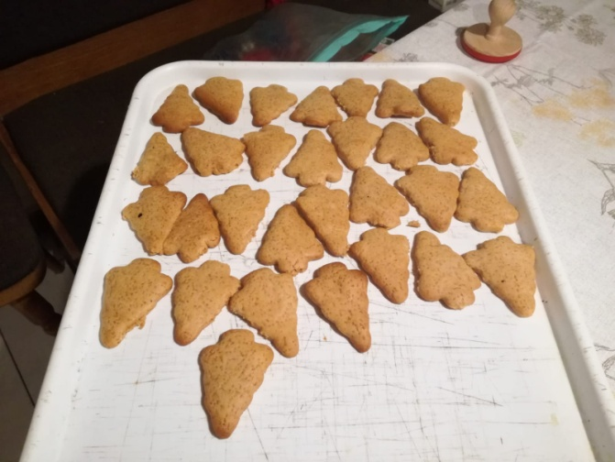
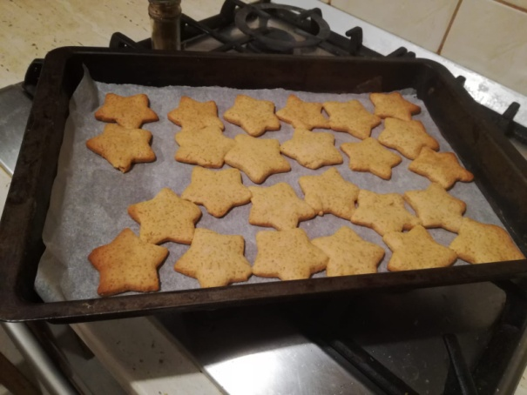
Work in progress…

Slide 8
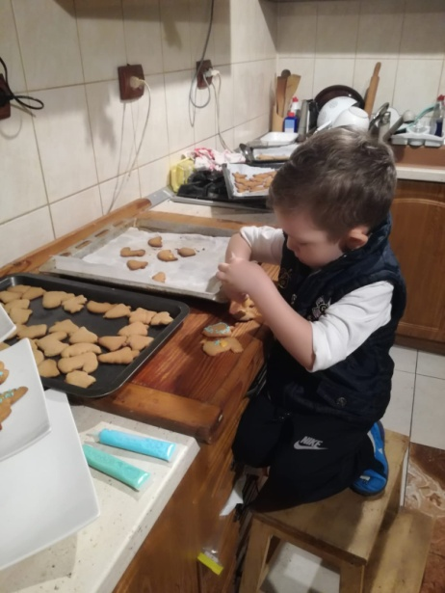
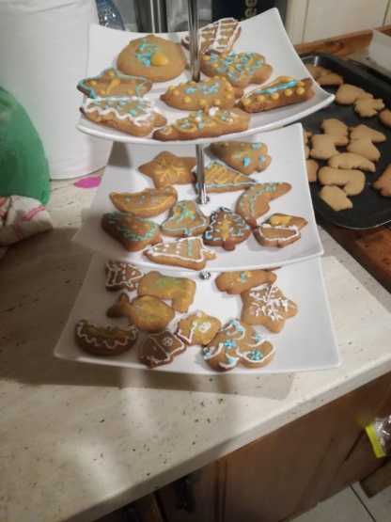
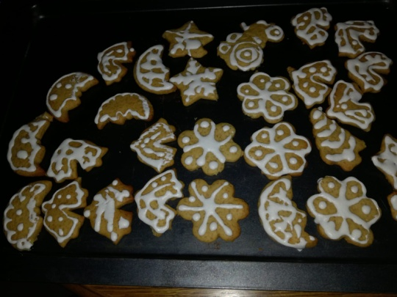
Still working…

Slide 9
Merry Christmas!

